Slide 1
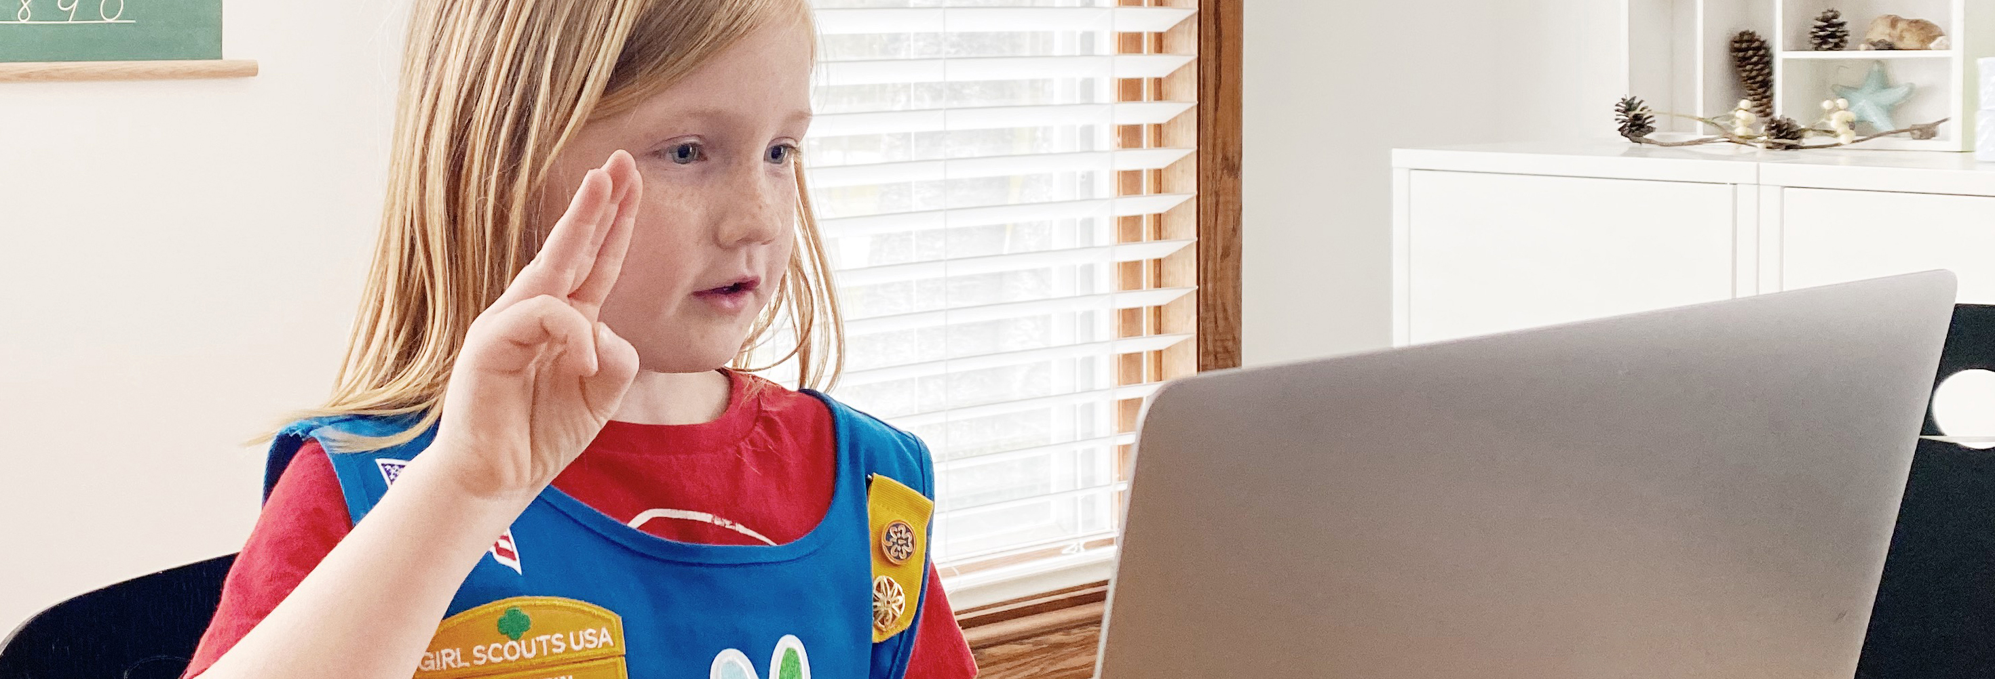
Welcome Troop _____! / PLUS SPACE FOR DATE IF NEEDED
Notes:
Here’s one style of title slide you can use.
NOTES FOR USAGE:
Customize this slide with your troop number and use this as a welcome for your girls. Log into your meeting platform at least 10 minutes early and show this slide so girls are welcomed as they arrive!
Use this template when including date beside bottom title text.
Photos:
Swap in photos of your troop if you have something that fits. To change photos, select image > right click > “Change picture.”
Crop and resize an image by double clicking the image. The crop tool appears in the Formatting Palette. Click on the crop tool to adjust.

Slide 2
Welcome
Troop ______!
Use to separate sections or to wake
everyone up with a bold statement.
Notes:
Here’s another title slide that doesn’t need a photo.
NOTES FOR USAGE:
This slide style is a TITLE PAGE that works if you don’t have your own photos.
Customize this slide with your troop number and use this as a welcome for your girls. Log into your meeting platform at least 10 minutes early and show this slide so girls are welcomed as they arrive!
You can also use this page to mark sections of your presentation.
Use it to pose a question or make a bold statement at the start of a new segment.

Slide 3
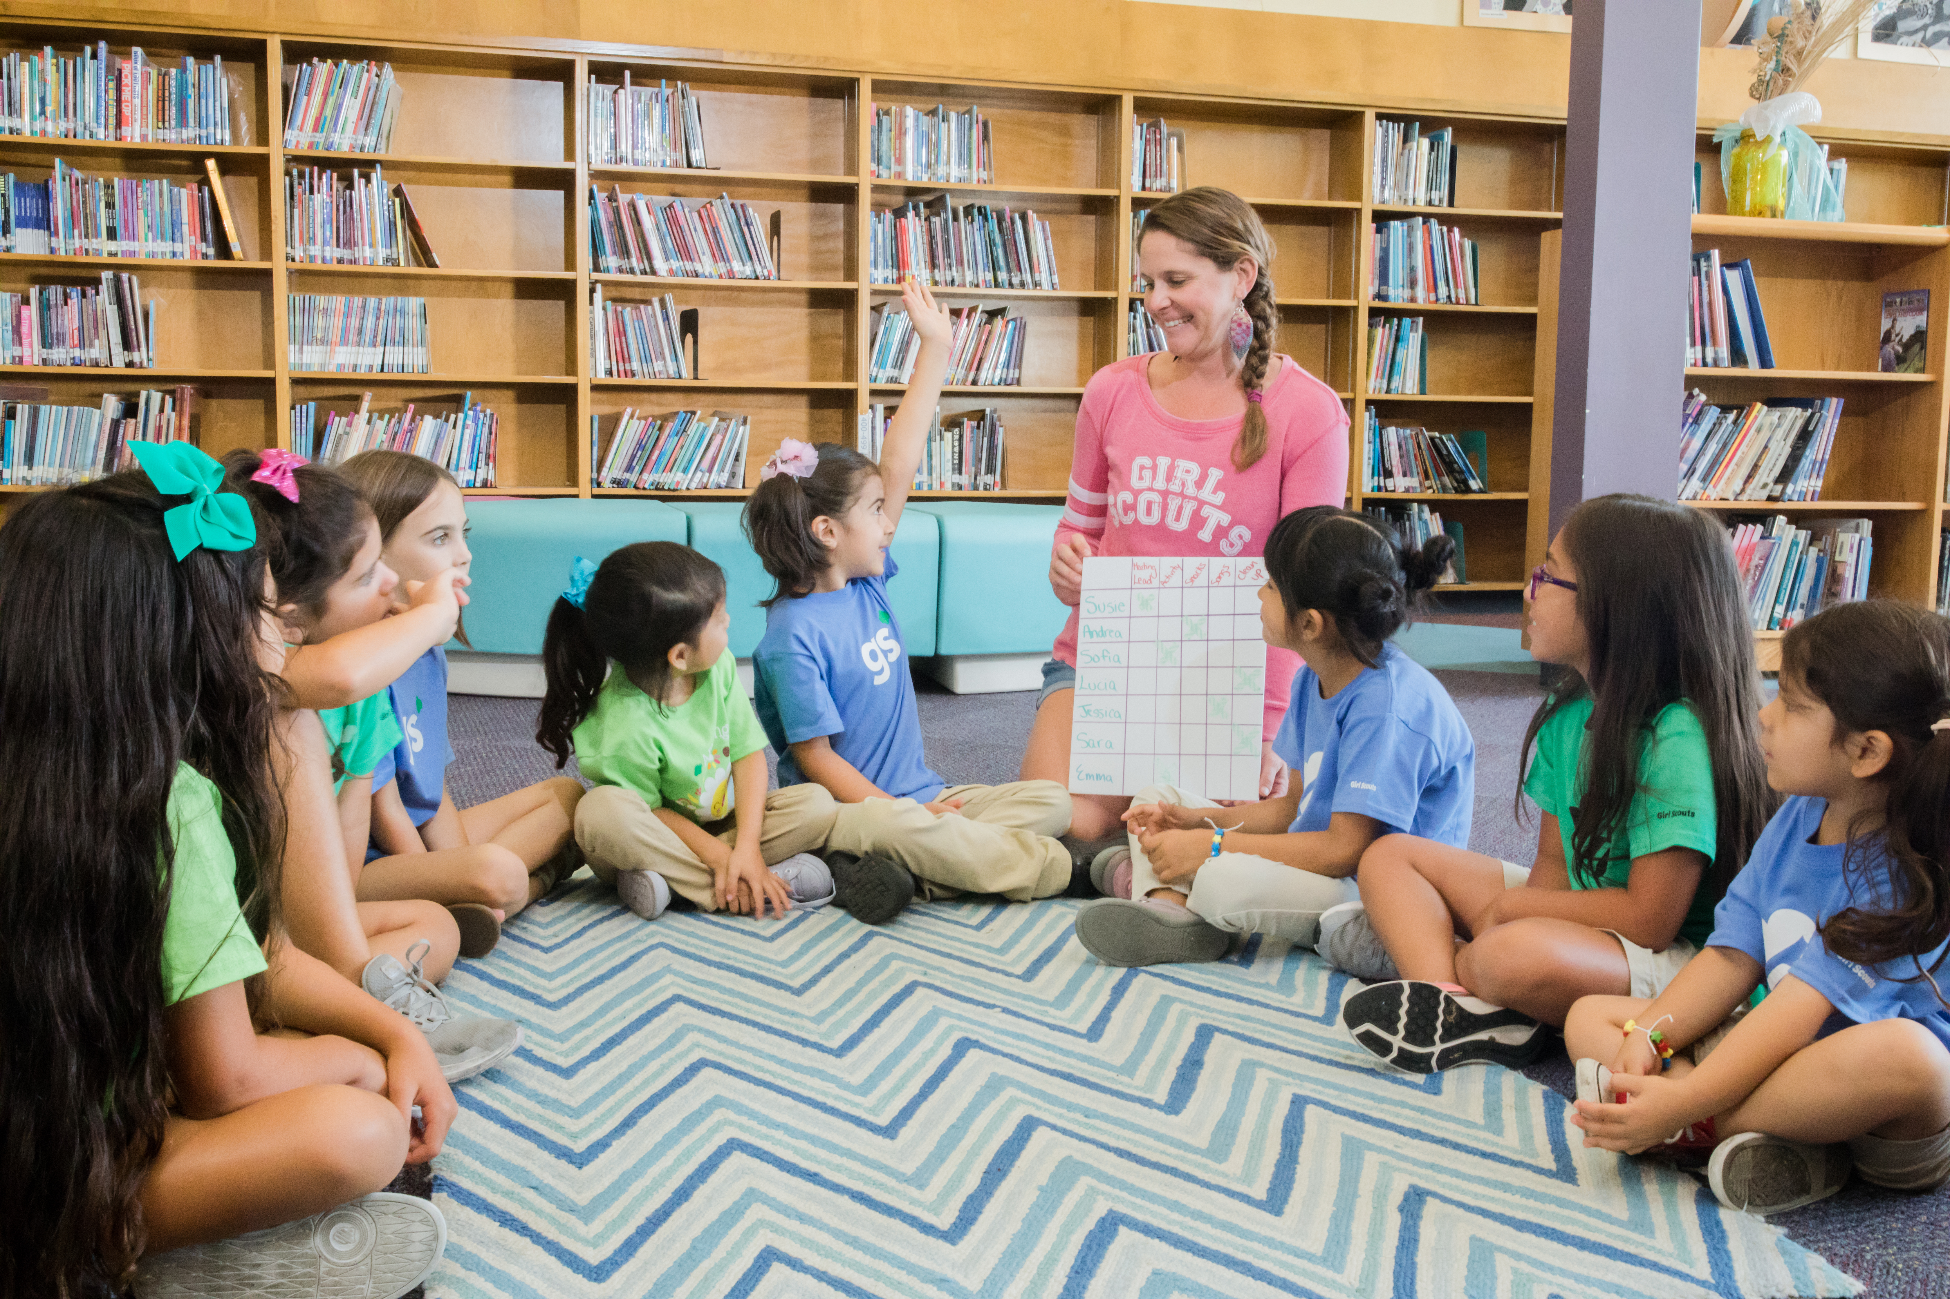
Our Troop’s Virtual Meeting Ground Rules
Establish rules and note them here
Keep ’em short and sweet
Review the rules at the start of each meeting
Notes:
NOTES FOR USAGE:
Establish ground rules regarding how girls will be able to share, and basic etiquette on microphone muting an unmuting and sharing their video. Share these rules at the very beginning of every meeting, so girls remember them and can follow them.
This slide style is TITLE & FULL-WIDTH IMAGE
Avoid extensive amount of bullet points and copy—slides are meant to support the narration of the speaker.
Reduce bullet points to keywords from your story. An audience can’t read and listen at the same time.
Use the notes section of your deck for further explanation of your slides.
For slide design with text only see “Layout” palette.
Photos:
Swap in photos of your troop if you have something that fits. To change photos, select image > right click > “Change picture.”
Crop and resize an image by double clicking the image. The crop tool appears in the Formatting Palette. Click on the crop tool to adjust.

Slide 4
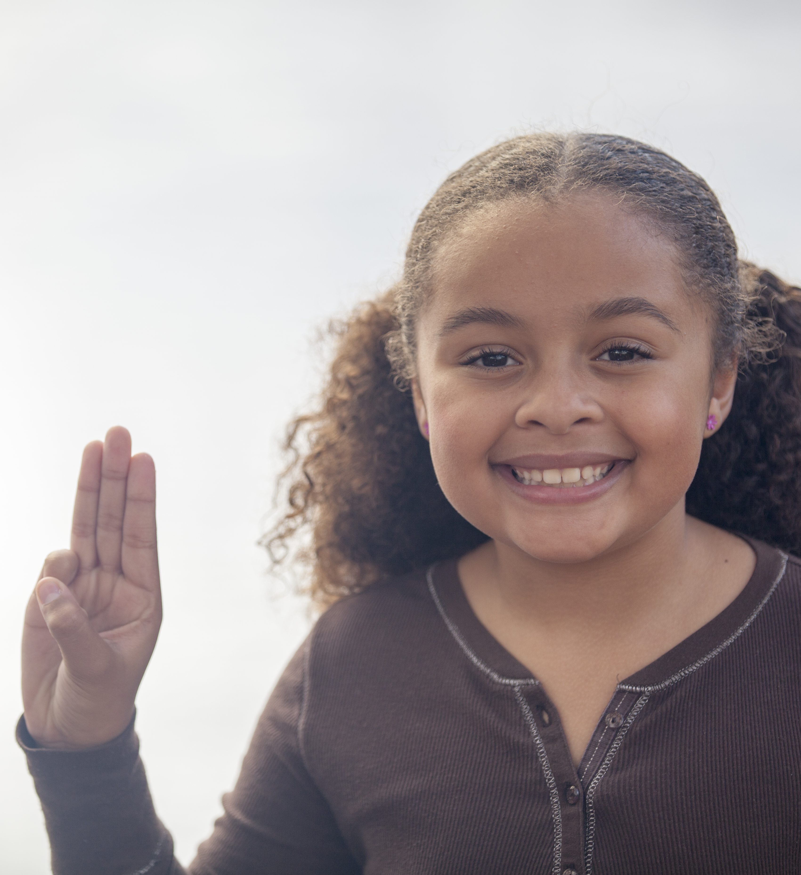
Let’s recite the Girl Scout Promise together.
The Girl Scout Promise
On my honor, I will try:
To serve God and my country,
To help people at all times,
And to live by the Girl Scout Law
Signs up!
Notes:
Start your meeting by reciting the Girl Scout Promise and Law together. Encourage the girls to have their cameras on (if possible) so they can all see each other. When reciting the Promise and Law, it might be helpful to have the girls mute themselves so they can follow your lead. Some digital connections cause delays in timing that make the girls out of sync, and this can be both confusing and frustrating for the girls.

Slide 5
Let’s recite the Girl Scout Law together.
The Girl Scout Law
I will do my best to be
honest and fair,
friendly and helpful,
considerate and caring,
courageous and strong, and
responsible for what I say and do,
and to
respect myself and others,
respect authority,
use resources wisely,
make the world a better place,
and be a sister to every
Girl Scout.
Notes:
Start your meeting by reciting the Girl Scout Promise and Law together. Encourage the girls to have their cameras on (if possible) so they can all see each other. When reciting the Promise and Law, it might be helpful to have the girls mute themselves so they can follow your lead. Some digital connections cause delays in timing that make the girls out of sync, and this can be both confusing and frustrating for the girls.

Slide 6







How are you feeling today?
Make the emoji face that matches how you are feeling!
Notes:
Use this slide to introduce your icebreaker. A sample icebreaker is included here. You can use this icebreaker or choose your own- whatever works best for you and your girls. You may also want to think about whether you will us the same icebreaker for each meeting or change it up from meeting to meeting. It’s entirely up to you! For suggestions on potential icebreakers to use with your troop, check out the tips sheet on digital icebreakers, which can be found on Girl Scouts at Home.

Slide 7
Meeting Activity
Give instructions here
What is the activity?
How long will we take to complete it?
Notes:
Use this slide to outline the meeting activity. Keep bullet points to directions only and keep them as short as possible. Provide any context for your girls verbally, including what badge you are working on and how this activity ties into the larger theme of the badge.
Images
You can drag images of badges and Journey awards from the Girl Scout Shop (https://www.girlscoutshop.com/BADGES-PROGRAM) to your PowerPoint slide if working on a badge or Journey activity.
Select an image from clip art or other sources that matches with the activity you’re are working on. For example, if you are working on an observation activity, you might choose a magnifying glass. Art activities might use a paint brush and pallet or an easel. Keep clip art matched to the activity and as simple as possible, so it does not distract from the instructions or your verbal directions.
Use additional slides for troop activities as necessary by duplicating the slide ad changing the directions to match the activity.

Slide 8
For Next Meeting
Provide an exciting title for the badge work here!
Give simple instructions, the same as you did for the activity.
What should the girls do?
How will they share their work? Should they send you a picture? Be prepared to share on your next virtual meeting?
Notes:
Not every badge activity can be completed during a virtual meeting. Keep girls engaged between meetings by giving them simple activities to do that tie into the badge you are working on. Be sure to set clear guidelines, including what they should do, what materials they will need, and how they should share their work.
After the meeting, follow up with parents and caregivers with instructions on the activities so they can assist their girl in working on the activity. Remind them that activities are always optional, so they do not feel pressure to complete the activities if it poses a challenge. Remember, this isn’t school and activities aren’t assignments! They are there only to provide an opportunity to keep girls excited and engaged with Girl Scouting.

Slide 9
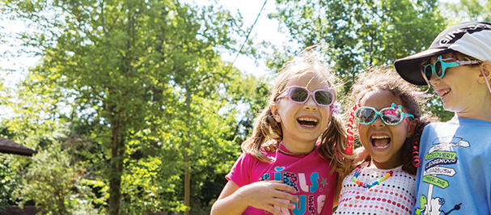
Make New Friends
  Make new friends, but keep the old
  One is silver, the other gold.
  A circle’s round, it has no end.
  That’s how long I want to be your friend.
Notes:
NOTES FOR USAGE:
End your meeting by singing Make New Friends. While singing on a virtual meeting is different and can definitely be challenging, it isn’t impossible! Ask the girls to mute themselves so that they can only hear you sing, and have them follow your lead. You can also rotate the responsibility of leading the song among the girls. Having them mute themselves makes it easier to follow along at their own pace, especially if their connection is delayed or the timing is off. While it’s nice for the girls to be able to hear themselves sing together, it can be discouraging and difficult to sing in unison virtually.
Photos:
Swap in photos of your troop if you have something that fits. To change photos, select image > right click > “Change picture.”
Crop and resize an image by double clicking the image. The crop tool appears in the Formatting Palette. Click on the crop tool to adjust.

Slide 10
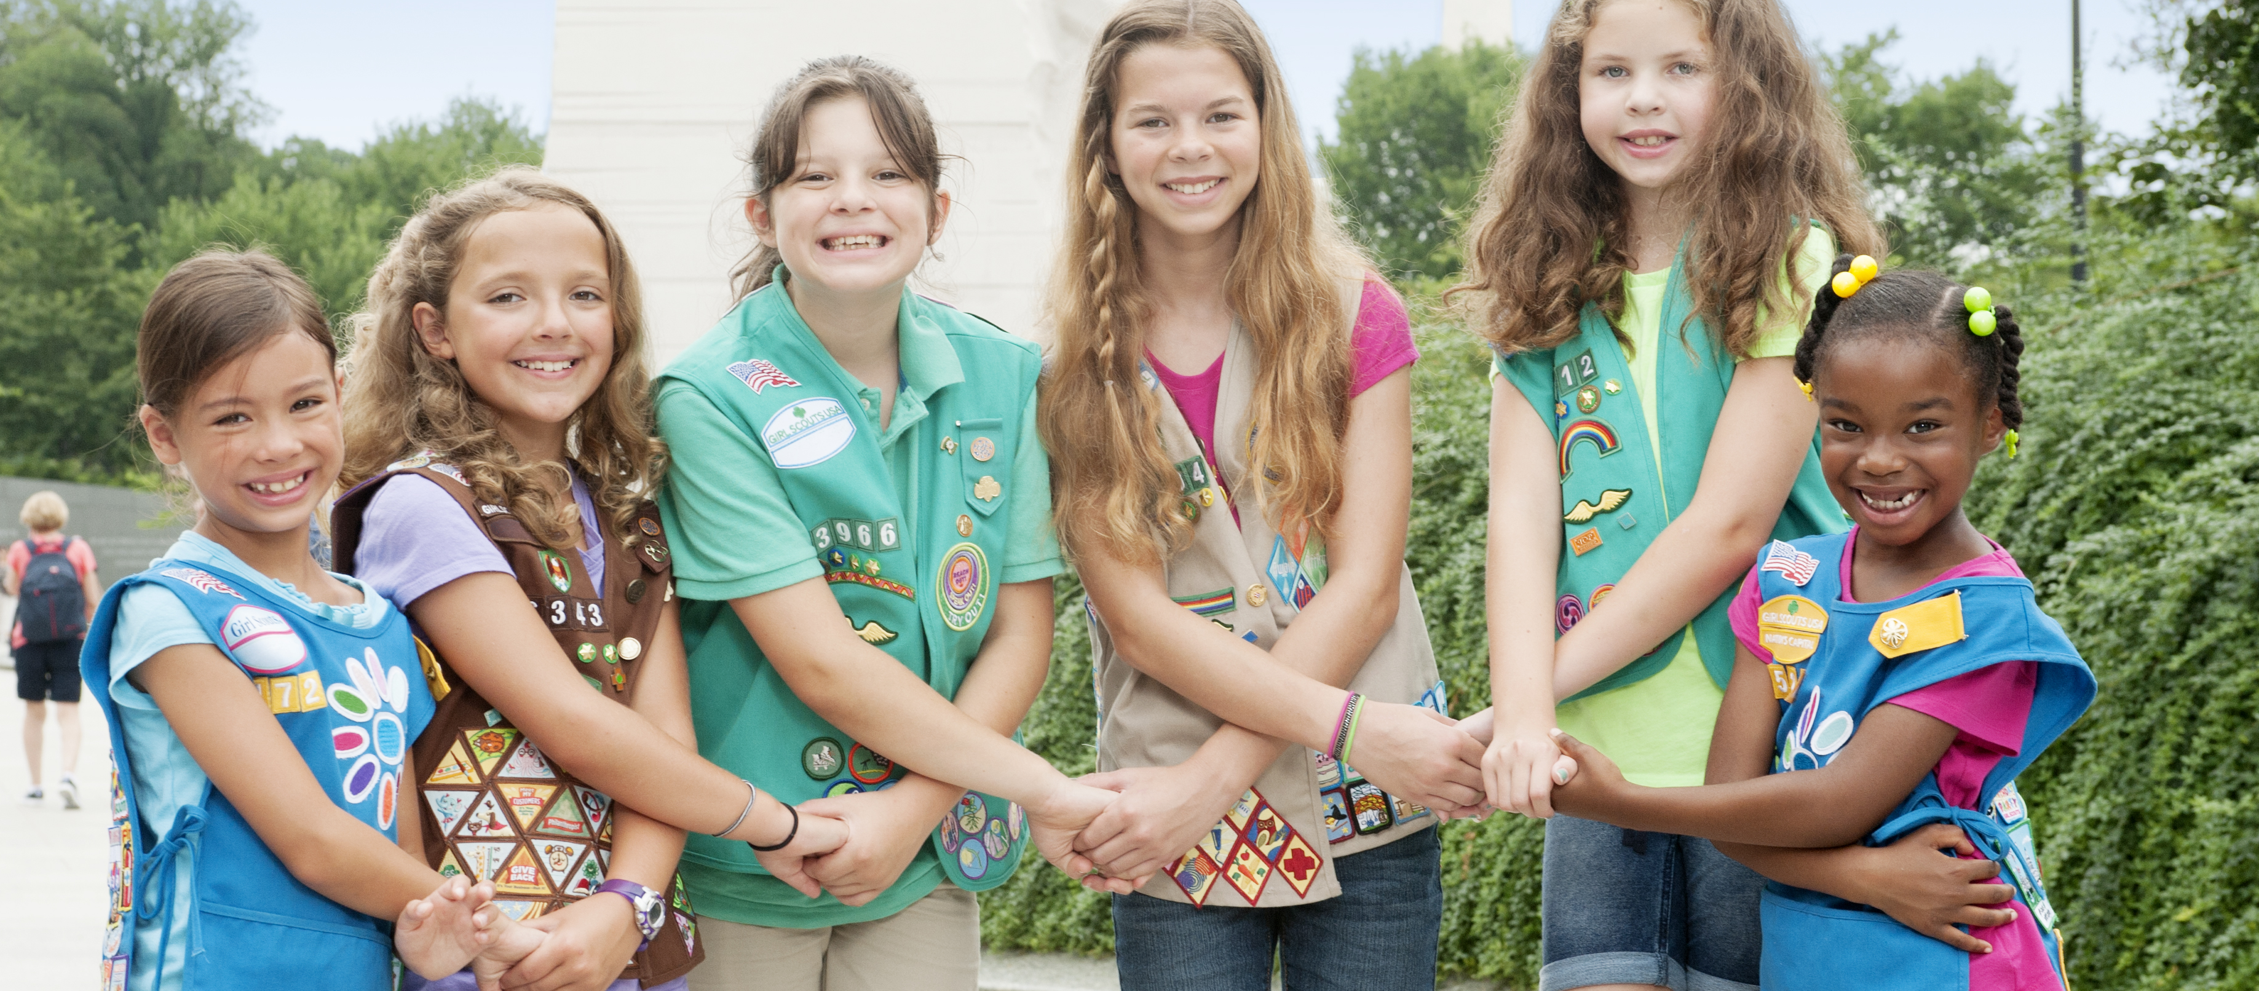
Close your eyes
Think of one great thought for your sister Girl Scouts.
On the count of three, pass it on!
Notes:
NOTES FOR USAGE:
The friendship circle is a challenge to do remotely, but it can be done! Encourage the girls to share this special time of the meeting with a sibling or even their favorite stuffed animal. Instruct them to cross their arms as they would if you were in person and squeeze their own hand (by making a fist) to virtually pass on the squeeze. Give them a moment to do that, then, on the count of three, instruct the girls to lift their arms over their heads to virtually “twist out.” It may take a few times to get used to this, but the girls will have fun with it!
Photos:
Swap in photos of your troop if you have something that fits. To change photos, select image > right click > “Change picture.”
Crop and resize an image by double clicking the image. The crop tool appears in the Formatting Palette. Click on the crop tool to adjust.

